Slide 1
Problem Solving Using Computers

Slide 2
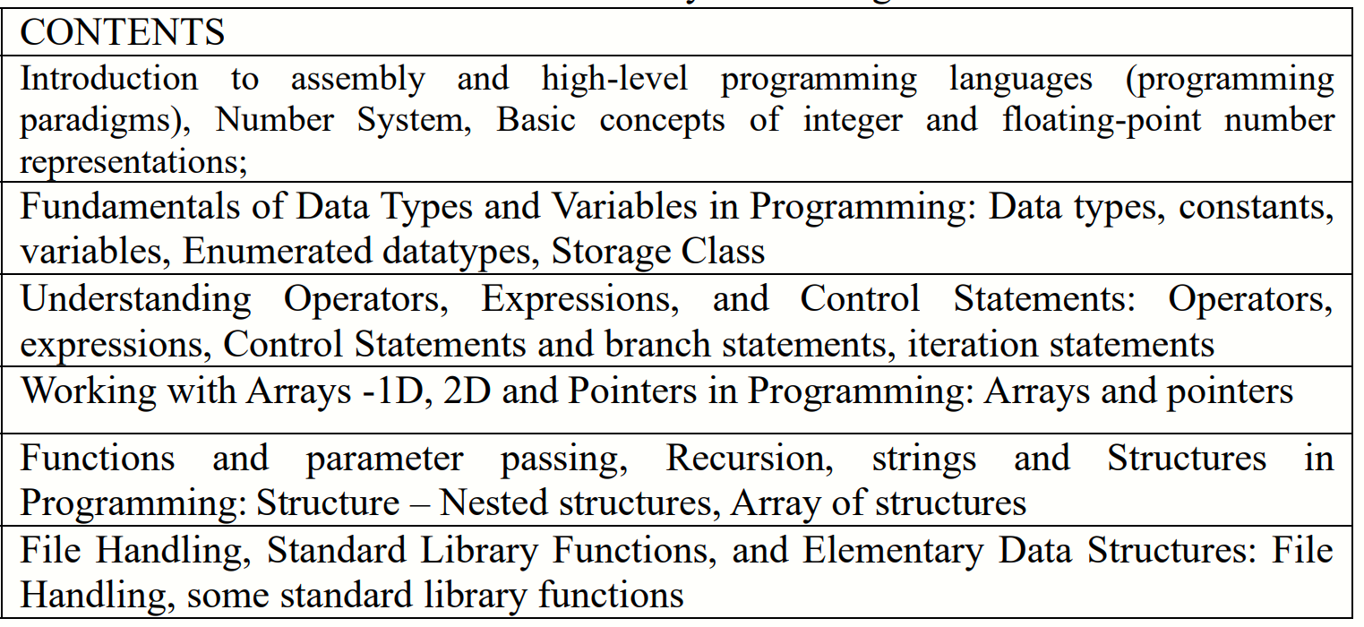
Syllabus
Notes:
Imperative programming: It is a software development paradigm where functions are implicitly coded in every required step to solve a problem. In imperative programming, every operation is coded and the code itself specifies how the problem is to be solved.

Slide 3

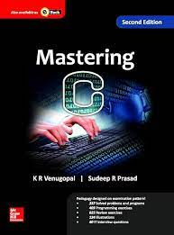

TEXTBOOKS
Masting C KR Venugopal

Slide 4
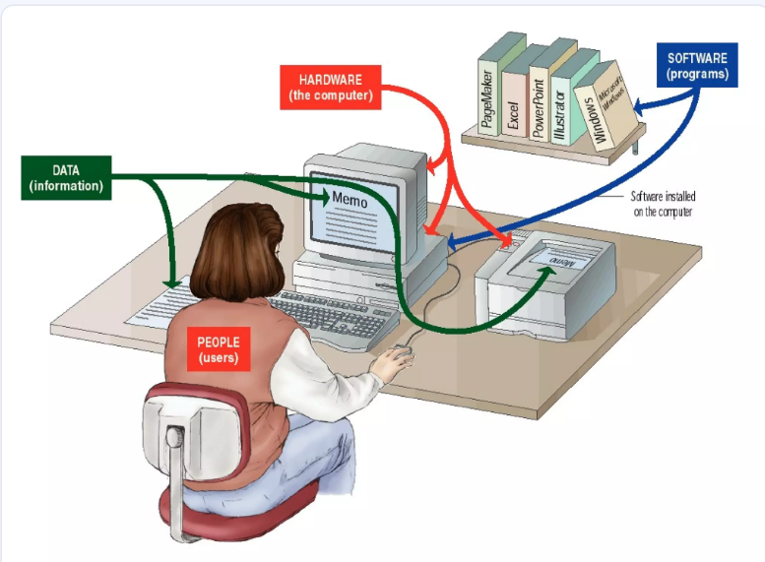

Slide 5
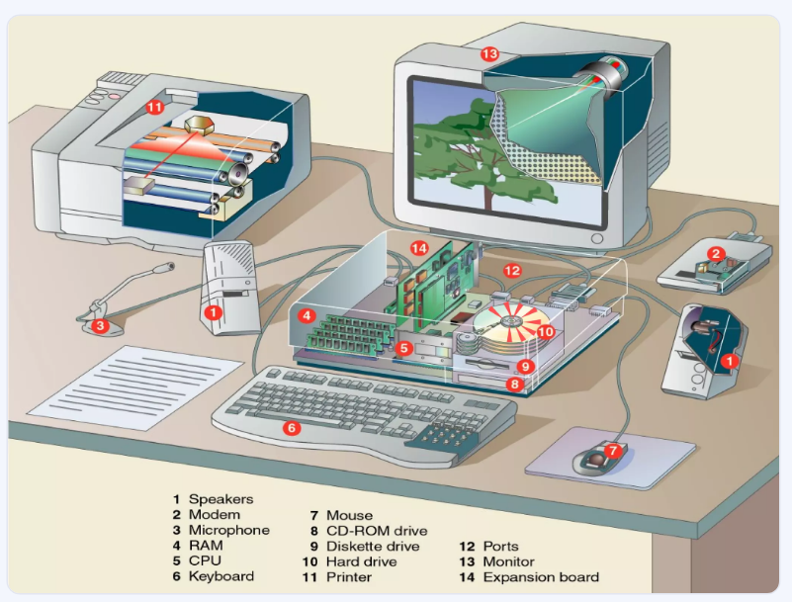

Slide 6
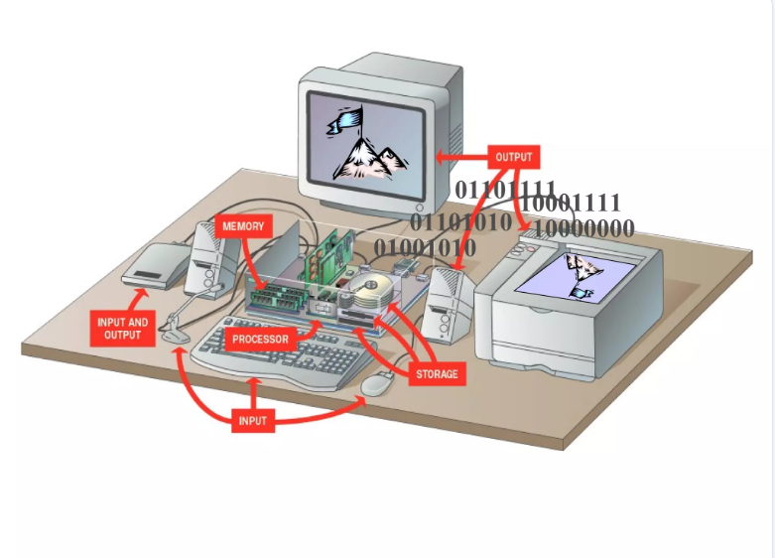

Slide 7
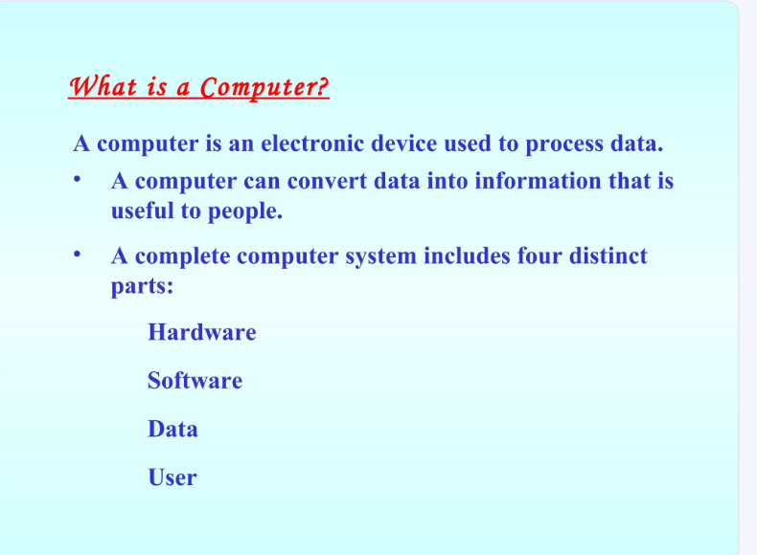

Slide 9

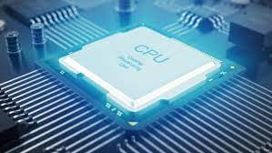
COMPUTER ORGANIZATION
Processor:
Manufacturing
It’s speed
Instructions per second (ON & off)/ clock cycle
P-1 1000Hz
P-4 3x10⁹ Hz= 3 GHz
Multi-core processer
Power:
16 bits v/s 64bits processer

Slide 10
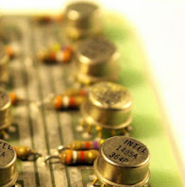
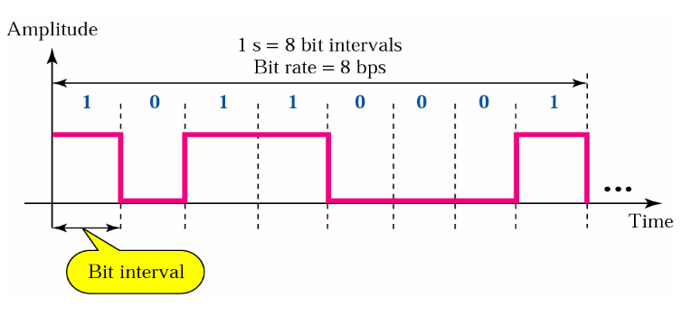
Register
Fastest I/o device
Flip-flop
Speed: 1ps =10⁻¹² sec.
16 bits to 64 bits
Qty: 24-32 registers
costly

Slide 11
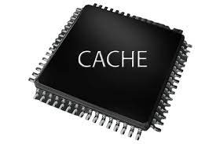
Cache Memory
Stores frequently used instructions and data
2nd Fastest I/o device
Transistors
Speed: 1ns =10⁻⁹ sec.
Size>4MB
costly

Slide 12
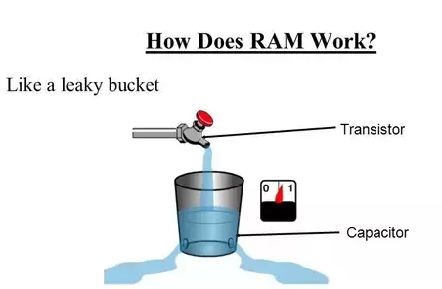
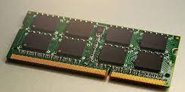
RAM(Random Access Memory)
Stores data temporary
Fastest I/o device
capacitors
Speed: 800 MHz =10⁻⁹ sec.
Size>1GB
costly

Slide 13
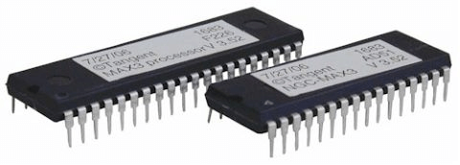
ROM(Read-Only Memory )
Stores permanent program into memory
Fastest I/o device
Speed: 5- 50 mHz
Size= 256MB
costly
EEPROM re-programmed for certain number of times only

Slide 14
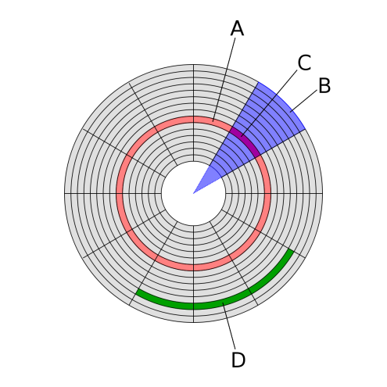
HDD
Stores permanent data in the form of magnetic/ de-magnetic (1/0).
slower I/o device
Magnetic material
Size>1TB
Segments :10¹⁰ X 512 byte FOR 1TB in 64 bits Operating System

Slide 15
HDD

Slide 16
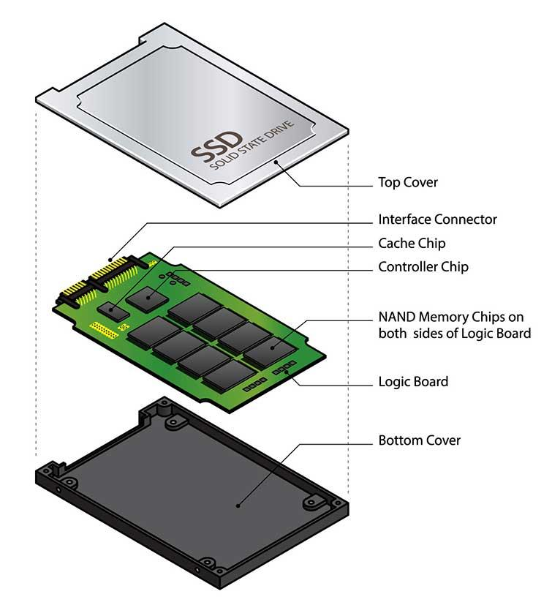
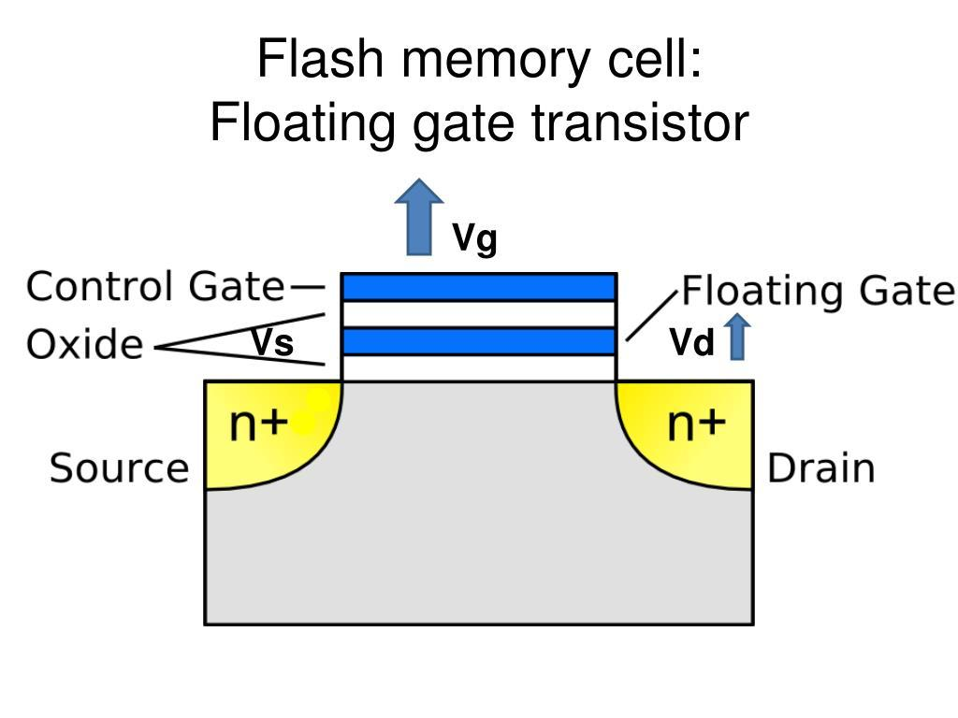
Solid-state drive (SSD)
Data is stored as electrical charges inside floating-gate transistors.
NAND Flash Memory (electronic memory cells).

